Slide 1
BME 153L.002
Biomedical Electronic Measurements I
Professor Marc Sommer

Slide 2
Today
Diodes!
  qualitatively, what are they? what do they do?
  i-v curve of a real diode
  ideal diode model (often good enough)
  offset diode model (more realistic)
  example circuits using both models
  LEDs

Slide 3
Diodes
They are passive circuit elements like resistors, capacitors, and inductors.
But while resistors, capacitors, and inductors are symmetric (carrying current in either direction equally well) diodes are NOT.
First-order approximation: they are little one-way streets of current.
See book for physics reason -- we’ll just cover how they are used here.

Slide 4
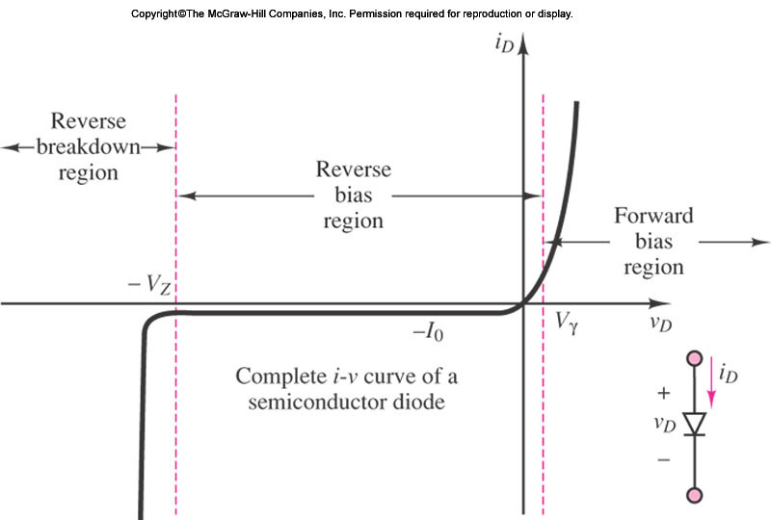
Diodes
i _{D}
+
-
v_{D}
Full i-v characteristic of a diode
“On”
Don’t
do this
“Off”

Slide 5
Diodes
i _{D}
+
-
v_{D}
Full i-v characteristic of a diode
“On”
“Off”
-I₀ ≈ 0
V_{γ} or “threshold”,
V_{Th} ≈ 0.6V

Slide 6
Diodes
i _{D}
+
-
v_{D}
Ideal i-v characteristic
“On”
“Off”
-I₀ ≈ 0
Ignore the threshold
if other voltages in
circuit > 0.6 V.

Slide 7
Diodes
i _{D}
+
-
v_{D}
Ideal i-v characteristic
if v_{D} > 0 V, short ckt
if v_{D} < 0 V, open ckt.
Like a voltage-controlled switch.
Real diode: white
Ideal diode: black
i _{D}
“On”
“Off”
v_{D}

Slide 8

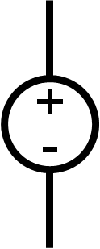

Analyzing ckts with ideal diodes
Let’s jump in and try one
R₁=5 Ω
R₃=10 Ω
+
-
v_{D}
v_{s}
_{=12V}
R₂=10 Ω
v_{B}
_{=11V}

Slide 9
Is diode On or Off ? Hmmm.
Don’t know a priori. So 1st step: assume.
R₁=5 Ω
R₃=10 Ω
If assume Off…
then open ckt.
+
-
v_{D}
v_{s}
_{=12V}
R₂=10 Ω
v_{B}
_{=11V}

Slide 10
R₁=5 Ω
R₃=10 Ω
If assume Off…
then open ckt.
Right node 11V
(why?)
11V
v_{s}
_{=12V}
R₂=10 Ω
v_{B}
_{=11V}

Slide 11
R₁=5 Ω
R₃=10 Ω
If assume Off…
then open ckt.
Right node 11V
How solve left node?
11V
v_{s}
_{=12V}
R₂=10 Ω
v_{B}
_{=11V}

Slide 12
R₁=5 Ω
R₃=10 Ω
If assume Off…
then open ckt.
Right node 11V
Left node 8 V
8V
11V
v_{s}
_{=12V}
R₂=10 Ω
v_{B}
_{=11V}

Slide 13
R₁=5 Ω
R₃=10 Ω
If assume Off…
then open ckt.
Right node 11V
Left node 8 V
Diode is reverse-biased
Consistent! Done
8V
11V
v_{s}
_{=12V}
R₂=10 Ω
v_{B}
_{=11V}

Slide 14
R₁=5 Ω
R₃=10 Ω
If assume On…
v_{s}
_{=12V}
R₂=10 Ω
v_{B}
_{=11V}

Slide 15
i _{D}
If assume On…
then short ckt.
and if it’s on, this means current flowing through it. Current must be in this direction (by definition, the ideal diode blocks current in other direction).
R₁=5 Ω
R₃=10 Ω
v_{s}
_{=12V}
R₂=10 Ω
v_{B}
_{=11V}

Slide 16
i _{D}?
If assume On…
then short ckt.
Good job for NVA: (on board)
V_{A}= 8.75 V
Hence current directed left!
FAIL. Can’t be.
Diode is OFF.
R₁=5 Ω
R₃=10 Ω
V_{A}
v_{s}
_{=12V}
R₂=10 Ω
v_{B}
_{=11V}

Slide 17
Offset diode model
More accurate.
In reality, the trigger for a diode switching between On and Off is when v_{D} crosses V_{TH} level.
If v_{D} > 0.6 V, ON (short)
If v_{D} < 0.6 V, OFF (open)
e.g. if v_{D} = 0.8 V (across real diode) then voltage across ideal diode is 0.2 V (see why?), it’s on.
and if v_{D} = 0.4 V, then voltage across ideal diode is -0.2 V, so it’s off.
It takes 0.6 V to short that diode.
0.6 V
➔
+
-
-
v_{D}
+
v_{D}

Slide 18
Offset diode model
e.g., what is v_{L} if v_{s} = 3cos(ωt)?
v_{s} will often cross the 0.6 V diode threshold.
Good circuit for ideal offset model.
+
v_{s}
v_{L}(t)
-
R_{L}

Slide 19
Offset diode model
e.g., what is v_{L} if v_{s} = 3cos(ωt)?
0.6 V
v_{s} will often cross the 0.6 V diode threshold.
Good circuit for ideal offset model.
Use same “assume on or off” procedure.
+
v_{s}
v_{L}(t)
-
R_{L}

Slide 20
Offset diode model
e.g., what is v_{L} if v_{s} = 3cos(ωt)?
0.6 V
1st let’s assume diode off.
+
v_{s}
v_{L}(t)
-
R_{L}

Slide 21
Offset diode model
e.g., what is v_{L} if v_{s} = 3cos(ωt)?
0.6 V
1st let’s assume diode off.
For circuit behavior to be consistent with diode off, must have v_{s} < 0.6 V.
In other words, when v_{s} < 0.6 V, diode off, v_{L} = 0 V.
v_{s}
0.6
+
v_{s}
v_{L}(t)
-
R_{L}

Slide 22
Offset diode model
e.g., what is v_{L} if v_{s} = 3cos(ωt)?
0.6 V
when v_{s} < 0.6 V, v_{L} = 0 V
v_{s}
0.6
+
2nd let’s assume diode on.
v_{s}
v_{L}(t)
-
R_{L}

Slide 23
Offset diode model
e.g., what is v_{L} if v_{s} = 3cos(ωt)?
0.6 V
when v_{s} < 0.6 V, v_{L} = 0 V
+
2nd let’s assume diode on.
For circuit to be consistent, must be that v_{s} > 0.6 V.
That is, when v_{s} > 0.6 V, diode shorts, v_{L}=v_{s}-0.6 V
v_{s}
v_{L}(t)
-
R_{L}

Slide 24
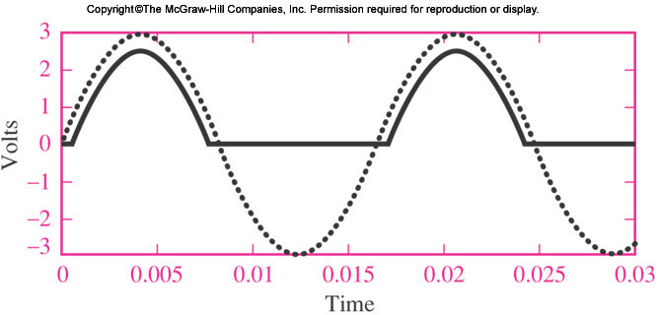
Offset diode model
e.g., what is v_{L} if v_{s} = 3cos(ωt)?
when v_{s} < 0.6 V, v_{L} = 0 V
+
when v_{s} > 0.6 V, v_{L} = v_{s}-0.6 V
v_{s}
v_{L}(t)
-
R_{L}
0.6 V
v_{L}
v_{s}
Note that whenever
v_{s} < 0.6 V, v_{L} stays at
a “floor” level of 0 V.

Slide 25
Offset diode model
This is called a rectifier circuit (specifically, a half-wave rectifier)
+
v_{s}
v_{L}(t)
-
R_{L}
v_{L}
v_{s}

Slide 26
One more example: “clipper”
now what is v_{L} if v_{s} = 3cos(ωt)?
R_{S} =100 Ω
+
v_{s}
v_{L}(t)
-
R_{L}
=1 MΩ
2 V

Slide 27

One more example: “clipper”
now what is v_{L} if v_{s} = 3cos(ωt)?
R_{S} =100 Ω
1st let’s assume diode off.
+
v_{s}
v_{L}(t)
.6 V
-
R_{L}
=1 MΩ
2 V

Slide 28
One more example: “clipper”
now what is v_{L} if v_{s} = 3cos(ωt)?
R_{S} =100 Ω
1st let’s assume diode off.
For circuit behavior to be consistent with diode off, v_{s} < 2.6 V.
≈v_{s}
+
2.6 V
v_{s}
v_{L}(t)
.6 V
-
R_{L}
=1 MΩ
2 V

Slide 29
One more example: “clipper”
now what is v_{L} if v_{s} = 3cos(ωt)?
R_{S} =100 Ω
1st let’s assume diode off.
For circuit behavior to be consistent with diode off, v_{s} < 2.6 V. So, v_{L} ≈ v_{s}
≈v_{s}
+
2.6 V
v_{s}
v_{L}(t)
.6 V
-
R_{L}
=1 MΩ
2 V

Slide 30
One more example: “clipper”
now what is v_{L} if v_{s} = 3cos(ωt)?
R_{S} =100 Ω
when v_{s} < 2.6 V, v_{L} ≈ v_{s}
≈v_{s}
2nd let’s assume diode on.
+
2.6 V
v_{s}
v_{L}(t)
.6 V
-
R_{L}
=1 MΩ
2 V

Slide 31
One more example: “clipper”
now what is v_{L} if v_{s} = 3cos(ωt)?
R_{S} =100 Ω
when v_{s} < 2.6 V, v_{L} ≈ v_{s}
2nd let’s assume diode on.
But now, v_{L} clamped at 2.6 V
This happens for v_{s} > 2.6 V
+
v_{s}
v_{L}(t)
.6 V
-
R_{L}
=1 MΩ
2 V

Slide 32
One more example: “clipper”
now what is v_{L} if v_{s} = 3cos(ωt)?
R_{S} =100 Ω
when v_{s} < 2.6 V, v_{L} ≈ v_{s}
when v_{s} > 2.6 V, v_{L} = 2.6 V
+
v_{s}
v_{L}(t)
(sketch on board)
.6 V
-
R_{L}
=1 MΩ
2 V

Slide 33
Light emitting diodes (LEDs)
video

Slide 34
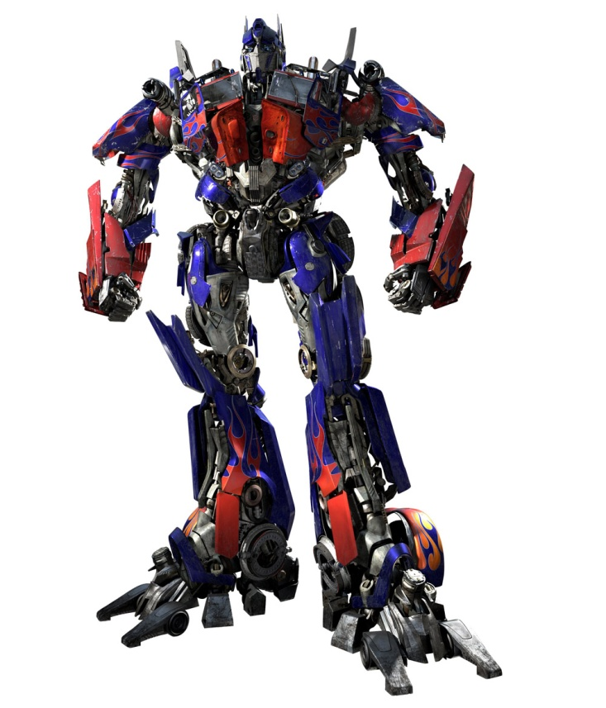
Next time: Thurs. March 24
Dr. Nightingale will be back.
Review diode sections: 9.1-9.4. Read 13.4.
Next topic (I think): Transformers

